Slide 1
2.5 Commutative, Associative, Distributive, and DeMorgan’s Laws
Commutative Laws
Associative Laws
Proof of Associate Law
X Y Z |  | XY YZ | (XY)Z X(YZ)
0 0 0 0 0 1 0 1 0 0 1 1 1 0 0 1 0 1 1 1 0 1 1 1 |  | 0 0 0 0 0 0 0 1 0 0 0 0 1 0 1 1 | 0 0 0 0 0 0 0 0 0 0 0 0 0 0 1 1

Slide 2
2.5 Commutative, Associative, Distributive, and DeMorgan’s Laws
Associative Laws for AND and OR

Slide 3
2.5 Commutative, Associative, Distributive, and DeMorgan’s Laws
AND
OR
Distributive Laws
Valid only Boolean algebra not for ordinary algebra
Proof

Slide 4
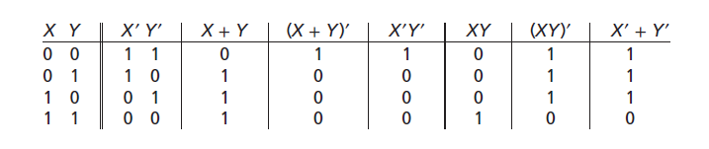
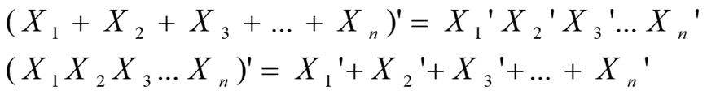
2.5 Commutative, Associative, Distributive, and DeMorgan’s Laws
DeMorgan’s laws
(X + Y)’ = X’Y’
(XY)’ = X’ + Y’
Proof with truth table
DeMorgan’s Laws for n variables

Slide 5
2.5 Commutative, Associative, Distributive, and DeMorgan’s Laws
DeMorgan’s laws application
Inverse of A’B+AB’
A B |  | A’ B | A B’ | F = A’B+AB’ |  | A’ B’ | A B | F’ = A’B’ + AB
0 0 0 1 1 0 1 1 |  | 0 1 0 0 | 0 0 1 0 | 0 1 1 0 |  | 1 0 0 0 | 0 0 0 1 | 1 0 0 1
Dual : formed by replacing AND with OR, OR with AND, 0 with 1, 1 with 0

Slide 6
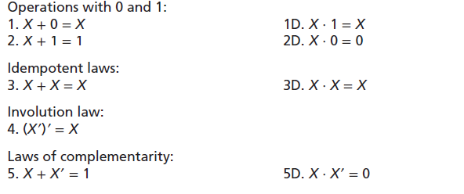
2.5 Commutative, Associative, Distributive, and DeMorgan’s Laws
Laws digest (Table 2-3)

Slide 7
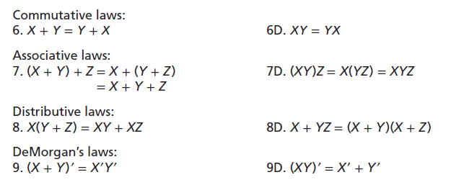
2.5 Commutative, Associative, Distributive, and DeMorgan’s Laws
Laws digest (Table 2-3)

Slide 8
2.6 Simplification Theorems
Useful Theorems for Simplification
Proof
Proof with Switch

Slide 9
Equivalent Gate Circuits
2.6 Simplification Theorems
=

Slide 10
2.7 Multiplying Out and Factoring
To obtain a sum-of-product form ➔ Multiplying out using distributive laws
Sum of product form
Still considered to be in sum of product form
Not in Sum of product form
Multiplying out and eliminating redundant terms

Slide 11
2.7 Multiplying Out and Factoring
To obtain a product of sum form ➔ Factoring using distributive laws
Product of sum form
Still considered to be in product of sum form
Not in product of sum form
Factoring to obtain a product of sum

Slide 12
2.7 Multiplying Out and Factoring
Circuits for SOP and POS form
Sum of product form
Product of sum form

Slide 13
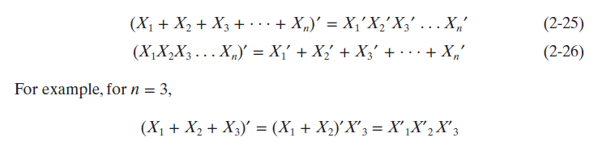
2.8 Complementing Boolean Expressions
Using DeMorgan’s Laws to find Inverse Expressions:
The complement or inverse of any Boolean expression can be found using DeMorgan’s Laws
DeMorgan’s Laws for n-variable expression
The complement of the product is the sum of the complements
The complement of the sum is the product of the complements

Slide 14
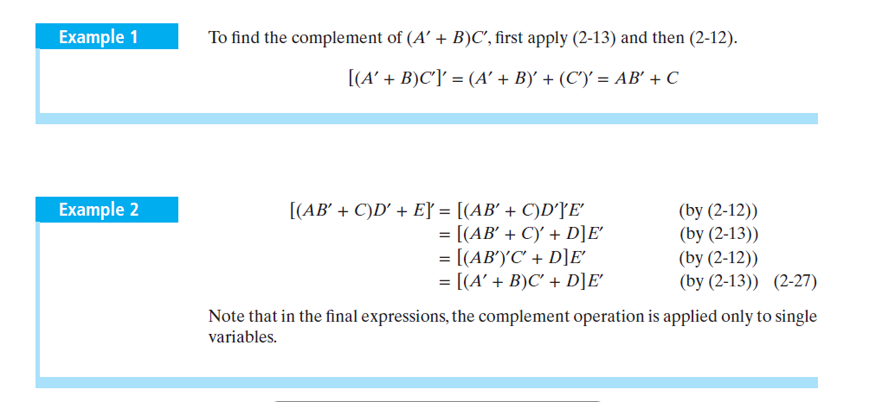
2.8 Complementing Boolean Expressions

